Slide 1
Indigenous Art using Mixtures

Slide 2
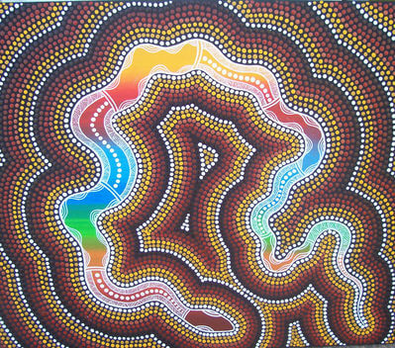
By the end of this lesson you should be able to:
Explain how paint is prepared as a colloid.
State where the Aboriginal peoples obtained their pigments.

Slide 3
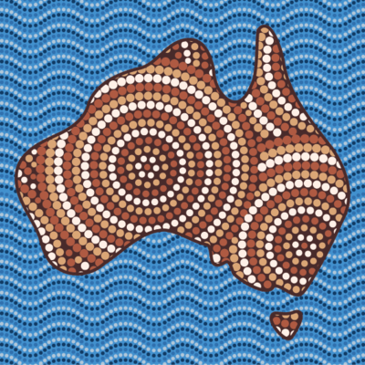
Paint is one of the oldest mixtures used by humans.
It is a colloid that has been used for art and ceremony for thousands of years.
Aboriginal peoples used paints for many reasons like this, and in this lesson we investigate how they were able to make them.

Slide 4
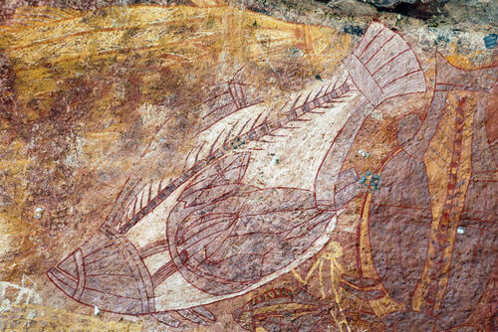
Australia is a huge place, and Indigenous Australians over this huge space developed many different cultures.
One way in which this is reflected is through their styles of art.
Australian rock art represents the oldest unbroken art tradition in the world. Some pieces depict Australia's extinct animals, while other pieces represent European ships and planes - this is a history that spans tens of thousands of years.

Slide 5
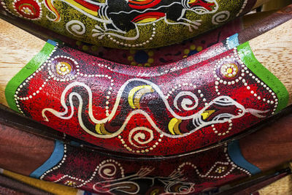
Indigenous artwork has many forms, including painted rock art, dot painting, bark painting and self-decoration (usually for ceremonial reasons).
Other non-painting forms include carving and sculpture.
As with all paints, the paints used in Aboriginal art were mixtures.

Slide 6
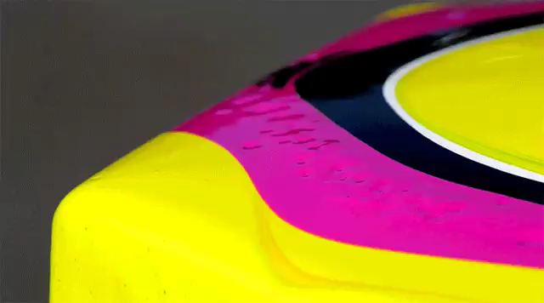
Paints require two things: a pigment, and a binder.
A binder is liquid that makes a paint able to be applied to a surface before it dries.
A pigment is the coloured substance that you want to apply as a paint

Slide 7
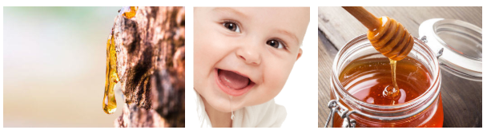
Indigenous Australians would mix coloured pigments with liquid binders to create paint.
Some common binders were saliva, honey, animal fat, tree resin and even blood.

Slide 8
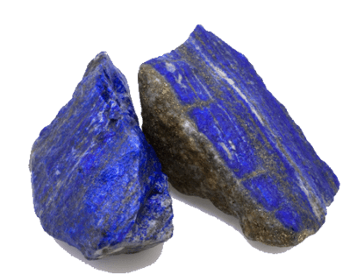
Paint is a colloid, so typically a pigment will suspend itself in the binder.
One example of a pigment is ultramarine. This deep blue colour was traditionally created from crushed lapis lazuli rock.
The blue colours used in history have been created from stones or plants which do not occur naturally in Australia. This means that use of blue colours in Indigenous Australian art is historically very rare.

Slide 9
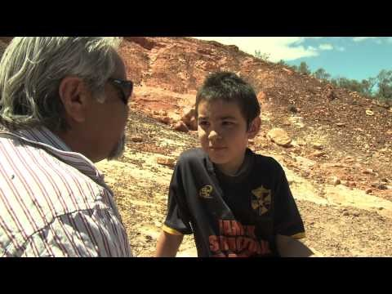

Slide 10
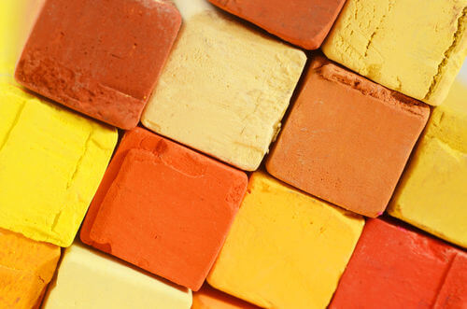
As discussed in the previous video, an important pigment for the Adnyamathanha peoples is ochre.
It is in fact an important pigment for many Indigenous Australian cultures.
Ochre is a type of clay rock which occurs in different colours (mainly red, white and yellow).
Grinding a type of ochre down to a fine powder allows the ochre to be suspended in a binder, creating yellow, white or red paint.

Slide 11
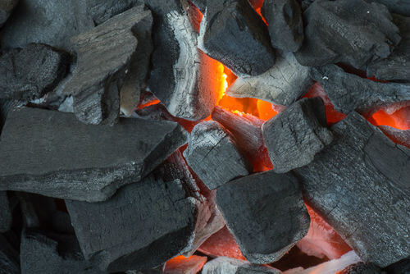
Burning wood on a fire will eventually create charcoal, a black, crumbly substance which is made up of carbon.
Charcoal was used to create black paint by crushing it before mixing it with a binder.

Slide 12
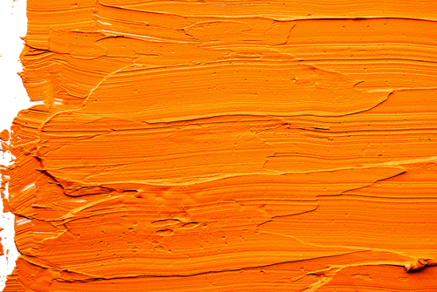
Orange paints could also be created, by mixing yellow and red paints.

Slide 13
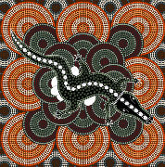
Orange, white, black, red and yellow are the traditional colours of Indigenous Australian art.
Many pieces of indigenous artwork use exclusively these colours, reflecting an ancient tradition - although most people have moved to using modern acrylic paints.

